Slide 1

Maven Pizzeria
End of Year Analysis

Slide 2
PROJECT OVERVIEW and GOALS
Analysis of a year's worth of sales from a Maven Pizzeria, including the date and time of each order and the pizzas served, with additional details on the type, size, quantity, price, and ingredients. Requested analysis being:
How many customers do we have each day? Are there any peak hours?
How many pizzas are typically in an order? Do we have any bestsellers?
How much money did we make this year? Can we identify any seasonality in the sales?
Are there any pizzas we should take off the menu, or any promotions we could leverage?

Slide 3
Methodology and Technology
Data Sources:
Maven Pizza dataset via https://mavenanalytics.io/
Data ETL and Cleaning:
Posgresql and pgAdmin 4 were used for ETL and Cleaning
Exploratory Data Analysis:
EDA performed using pgAdmin 4 and Tableau
Data Visualizations:
Data visualizations created initially in pgAdmin 4, enhanced in Tableau
Dashboard:
Dashboard created in Tableau

Slide 4
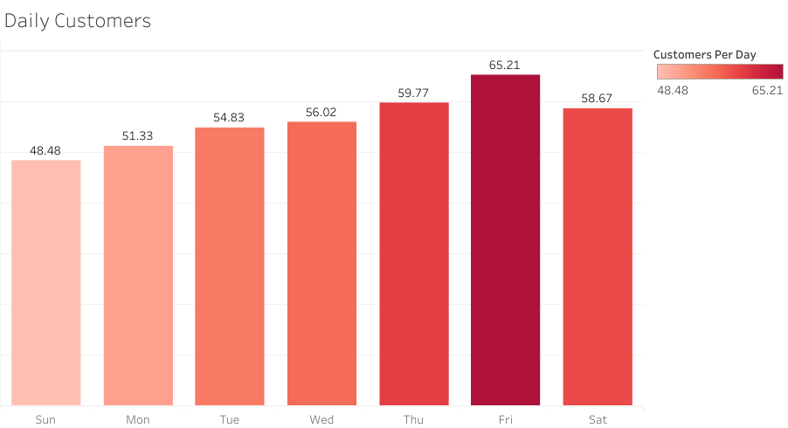
Customers Each Day
On average:
Friday is the busiest day of the week.
Sunday is the slowest day of the week.

Slide 5
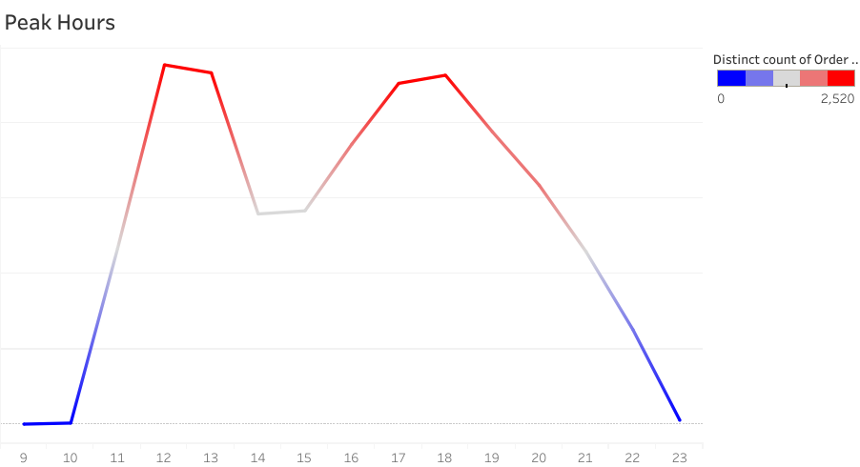
Peak Hours
12:00-1:00
and
6:00-7:00
are our
peak hours

Slide 6
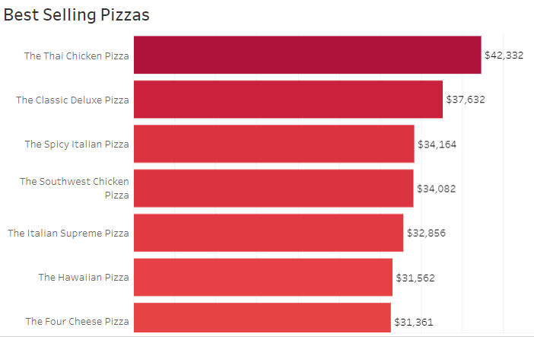
Pizzas Per Order / Best Sellers
We average 1.019 pizzas per order.
We should try to increase this number through promoted sales.

Slide 7
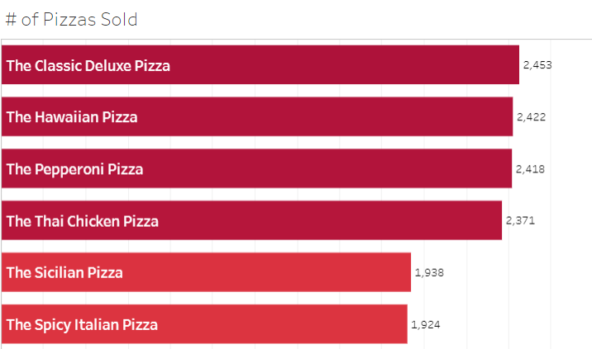
Most pizza types sold
Customers love the Pepperoni and Sicilian pizzas;
however, these two pizza types don’t account for our top revenue earning pizzas.

Slide 8
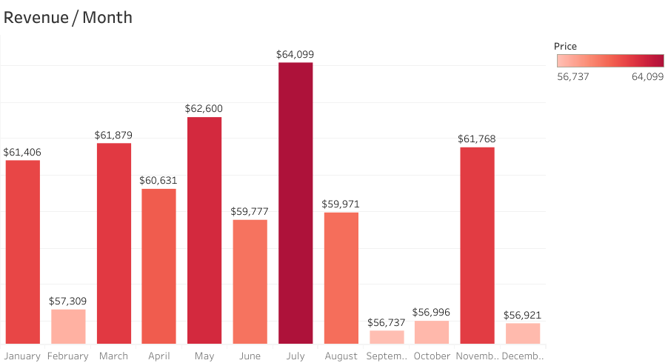
Monthly Revenue

Slide 9
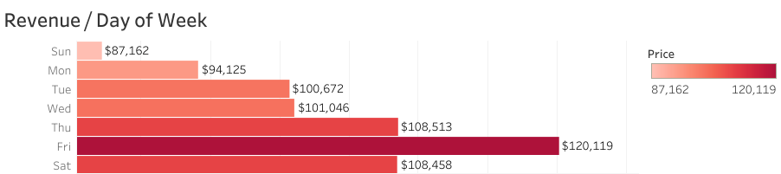
Revenue By Day of Week
As with our daily customer counts, our top earning day of the week is Friday.
The worst performing day of the week for revenue is Sunday.

Slide 10
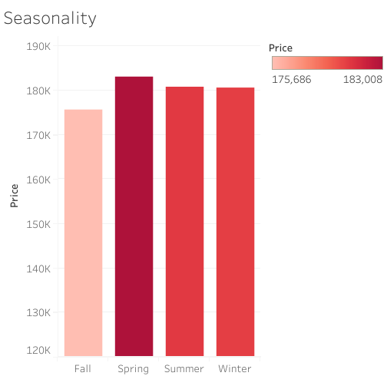
Seasonality revenue
Spring is our best-selling season.
Summer and Winter are comparable in revenue.
Fall is our worst performing season for revenue.

Slide 11
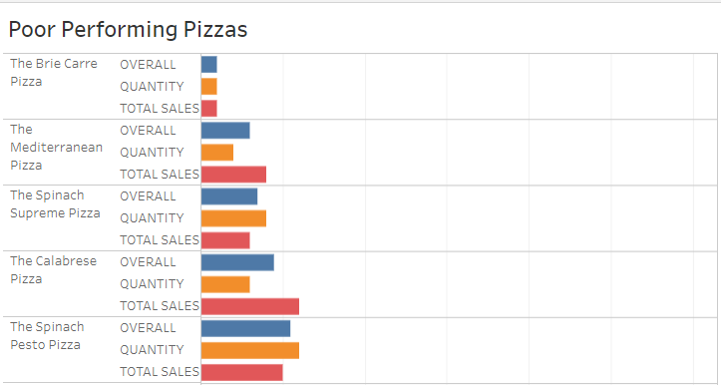
Poor Performing Pizzas

Slide 12
Potential Promotions
Being that Pepperoni and Sicilian pizzas are so popular, yet are not among the highest earning pizzas, we could promote a multi pizza deal to help increase revenue and our pizza per order number of 1.01 because we know our customers love these two pizzas.
Sundays are our worst selling days. Fall is our worst selling season. Fall and Sundays is the perfect combination for a special promotion for NFL Football fans. We may be able to run a special take-out promotion to increase revenue.

